Slide 1
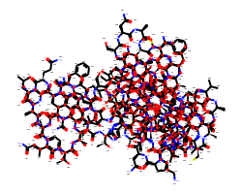
SLFEQLGGQAAVQAVTAQFYANIQADATVATFFNGIDMPNQTNKTAAFLCAALGGPNAWTGRNLKEVHANMGVSNAQFTTVIGHLRSALTGAGVAAALVEQTVAVAETVRGDVVTV
CC[C@H]CC[C@H](C)…….(CCC(N)=O)NC(=O)[C@
(C)[C@H](NC(=O)CNC(=O)[C@H](CC(N)=O)NC(=O)[C@H]
Sample Plasmid sequence
Protein Sequence to SMILE Conversion
SMILE to Protein Graph

Slide 2
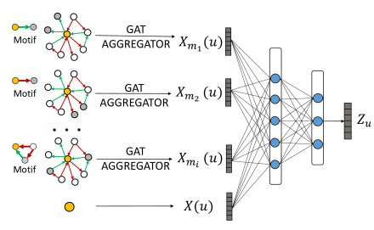
Captures the Structural Information form the protein
Hidden Representation for Protein Graph
XGB Classifier
Probability for Lab of origin
Protein Graph
Graph Attention Network
(Figured acquired from https://www.groundai.com/project/signed-graph-attention-networks/1)
AT, GC, GCC, ACC, TSA, VQA, RSALT, SALT…
Merging the Representation form Protein Graphs along with n-Gram Features
N-Gram Features from Protein Sequences

Slide 3
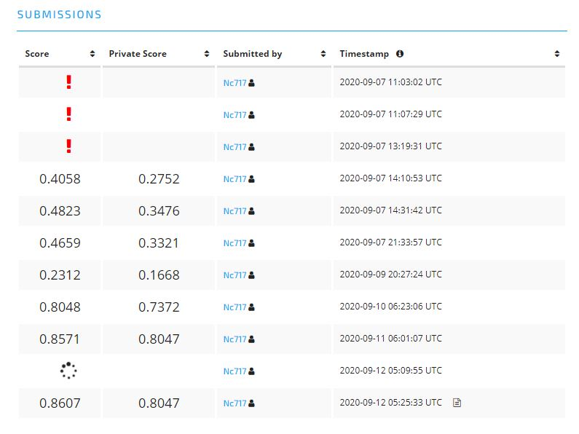
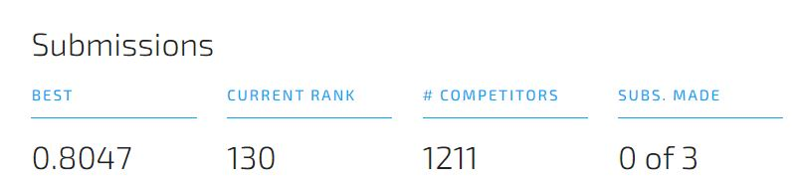
Final Score and Rank secured in the challenge

